Slide 1


Adaptive Leadership & Change Management
Copyright 2025 Altruist Impact Accelerator, all rights reserved.
Licensed for noncommercial use only under the Terms of Service.

Slide 2
The Challenge
1
The two sides of change
  Effective organization design AND effective leadership
  Technical change versus adaptive/personal/cultural change
  Leaders design the orgs but change cannot be controlled from the top
  Each org unit and staff person must evolve to align with goals provided by leadership
2
Top down VS bottom up
3
Org Change starts with Personal Change
Copyright 2025 Altruist Impact Accelerator, all rights reserved.
Licensed for noncommercial use only under the Terms of Service.

Slide 3
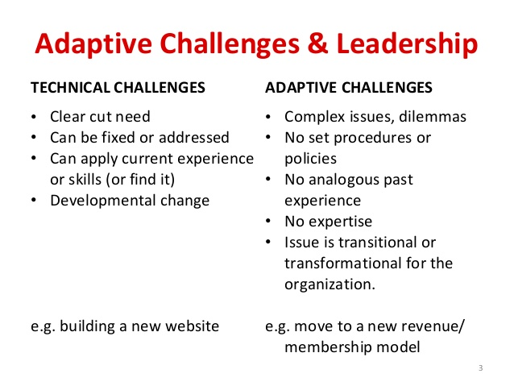
The Challenge
1
Preparing for adaptation
  I can do this, I’ve done it before, right?
  Learning/curious mindset
  Understand why transformations fail
  Each org unit and staff person must be motivated for ground-up action.
2
Being intentional about change
3
Who is on the change team?
Copyright 2025 Altruist Impact Accelerator, all rights reserved.
Licensed for noncommercial use only under the Terms of Service.

Slide 4

Preparing for Change: Fixed vs Growth Mindsets
Learner vs. Knower: curiosity?
Player vs. Victim: accountability?
Me vs. Mission: selfish or altruistic?
Copyright 2025 Altruist Impact Accelerator, all rights reserved.
Licensed for noncommercial use only under the Terms of Service.
Notes:
Jacques-Louis David 1791 “Belisarius begging for alms ”

Slide 5

Mindset Shift #1
Learner (expert + certainty) vs. Knower: (expert + curiosity)
  Learner
  experience = subjective = not all of the truth
  important to be effective
  Self-worth linked to being effective (ego in back seat)
  Knower
  experience = reality = truth
  important to be right
  Self-worth linked to being right (vulnerable ego)
Copyright 2025 Altruist Impact Accelerator, all rights reserved.
Licensed for noncommercial use only under the Terms of Service.
Notes:
Jacques-Louis David 1791 “Belisarius begging for alms ”

Slide 6
Mindset Shift #2
Player (challenge + response) vs. Victim: (threat + blame)
  Player
  Responds to challenges
  Was I effective? Could I have been more prepared?
  What can I learn from this?
  Victim
  Places blame for what happens
  Why did they do this to me?
  What am I owed? Who is to be punished?
Copyright 2025 Altruist Impact Accelerator, all rights reserved.
Licensed for noncommercial use only under the Terms of Service.
Notes:
Jacques-Louis David 1791 “Belisarius begging for alms ”

Slide 7
Mindset Shift #3
Team member (org first) vs. me: (me first)
  Team Player
  Act with the organization and mission top of mind
  Partner with mastery: communicate across the 4 working styles
  Create shared goals and coordinated action
  Me
  Four types of power (dominator, interrogator, aloof, victim)
  Career advancement/stepping stone
  Resistance to personal/behavioral change
Copyright 2025 Altruist Impact Accelerator, all rights reserved.
Licensed for noncommercial use only under the Terms of Service.
Notes:
Jacques-Louis David 1791 “Belisarius begging for alms ”

Slide 8
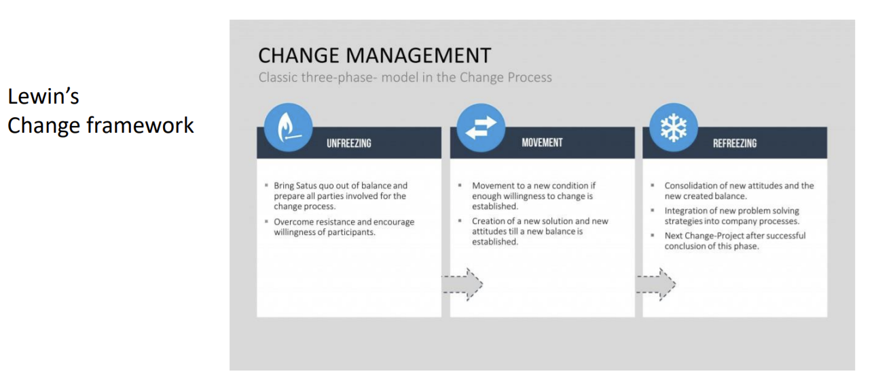
Change Management Framework #1
Copyright 2025 Altruist Impact Accelerator, all rights reserved.
Licensed for noncommercial use only under the Terms of Service.

Slide 9
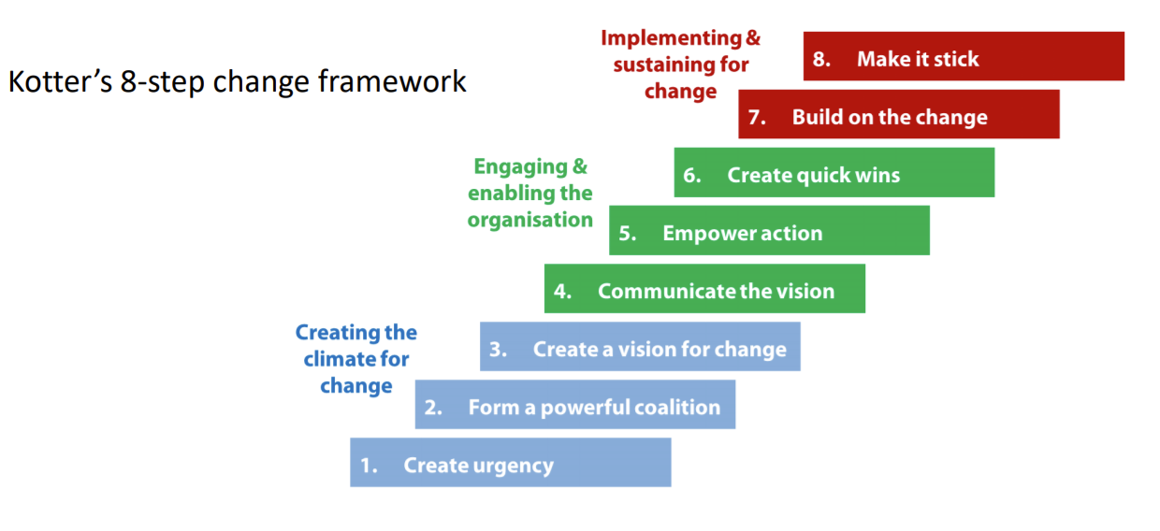
Change Management Framework #2
Copyright 2025 Altruist Impact Accelerator, all rights reserved.
Licensed for noncommercial use only under the Terms of Service.

Slide 10
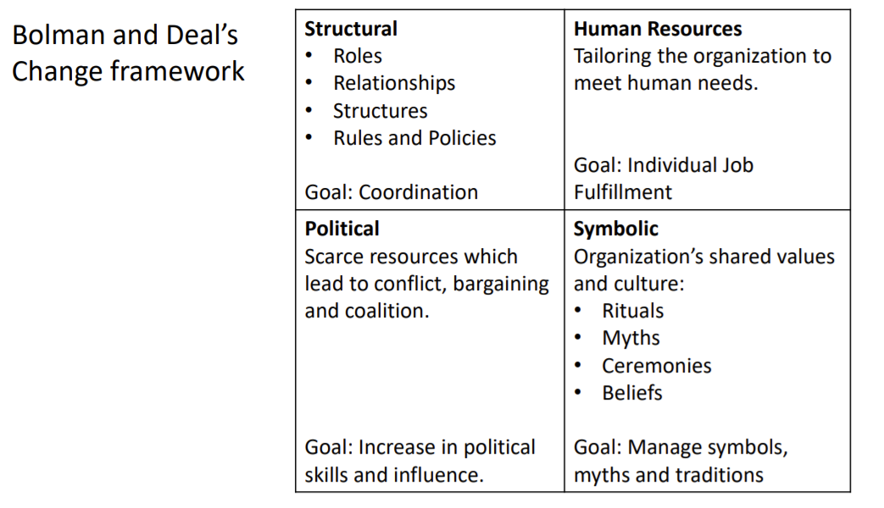
Change Management Framework #3
Copyright 2025 Altruist Impact Accelerator, all rights reserved.
Licensed for noncommercial use only under the Terms of Service.

Slide 11
In Sum
  Be intentional
  Establish the Superscript (positive framing)
  Call out the Subscript (whispers, subverting behavior)
  Are you on the bus?
  Low Dose, High Frequency
Copyright 2025 Altruist Impact Accelerator, all rights reserved.
Licensed for noncommercial use only under the Terms of Service.

