Slide 1
BELLEVUE LIFESPRING
Copyright 2025 Altruist Impact
Licensed for noncommercial use only under the Terms of Service
Food, clothing, scholarships and emergency assistance for Bellevue’s most vulnerable children
v.08.28.2019

Slide 2

Challenge
Bellevue School District:
Children experiencing homelessness
Poverty in Bellevue is accelerating.
18% of Bellevue School District students (3,600) qualify for Federal Meal Support ($47,000 annual income for family of 4).
Cost of living in Bellevue is skyrocketing:
$88,000 for family of 4.
Nearly 300 students are experiencing homelessness.
Copyright 2025 Altruist Impact Accelerator, all rights reserved.
Licensed for noncommercial use only under the Terms of Service.

Slide 3

Challenge
2017 Bellevue Achievement Rates
Poverty costs children 13 IQ points*
Copyright 2025 Altruist Impact Accelerator, all rights reserved.
Licensed for noncommercial use only under the Terms of Service.

Slide 4
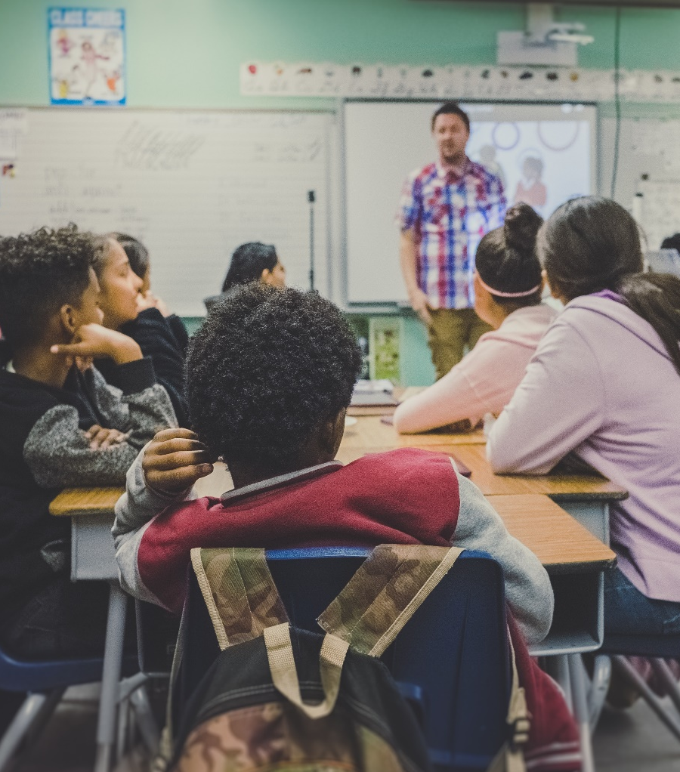
Challenge
2018 Bellevue School District Graduation Rates
Every dropout costs us $1 million*
Copyright 2025 Altruist Impact Accelerator, all rights reserved.
Licensed for noncommercial use only under the Terms of Service.

Slide 5
Client Profile
Typical Rental Assistance Family
Average monthly income is $1,890
Nearly 70% are single parents
Average household size is 3.5
Ethnically diverse
Average assistance disbursement is $890
Copyright 2025 Altruist Impact Accelerator, all rights reserved.
Licensed for noncommercial use only under the Terms of Service.

Slide 6
Solution
Comprehensive programs to support basic needs
Clothing for children and their families
Clothing
Food
Food for hungry children during school breaks and snacks during the school year
FAMILY
SCHOOL
HUMAN SERVICES
Emergency
Assistance
Education
Emergency assistance with move-in assistance, eviction prevention and holiday gifts
Education support for summer school, credit recovery and college
Copyright 2025 Altruist Impact Accelerator, all rights reserved.
Licensed for noncommercial use only under the Terms of Service.

Slide 7




Why Us?
100-year history
Known and trusted by established Bellevue leadership and school district
Strong, diverse, deeply
connected board
Direct, comprehensive services
for children in Bellevue
Copyright 2025 Altruist Impact Accelerator, all rights reserved.
Licensed for noncommercial use only under the Terms of Service.

Slide 8
Our Team
Executive Director
Membership Circles
Jennifer Fischer
Clemmie Evans Circle
Fairweather Circle
One Circle
5-year tenure, Bellevue Downtown Association and Seafair experience
Downtown Circle
Hunts Point Circle
Yarrow Point Circle
Enatai Circle
Kemper Freeman Circle
Youth Council
Board of Directors
Tracy Wort, President & Board Chair, Symetra
Lisa James, Hedge & Vine
Joseph Brazen, Brazen Group Properties & Restauranteur
Ken Kilbreath, Wells Fargo Private Bank
Julie Cheng Bui, Philanthropist & Writer
Benjamin Lee, Hong Kong Association of Washington
Trish Carpenter, Former Sales and Marketing, Fortune 500
Debbie Oberbillig, Success View Consulting
Darin Chestnut, PCL Construction
Barbara Quinn, Retired Educator
Sabrina Smith Delery, Windermere Yarrow Bay
Linda Reid, Retired Financial Professional
Dr. Ivan Duran, Superintendent, Bellevue School District
Ken Russell, Access Accounting and Tax Services
Keri Ellison, Youth Advocate and Retired Business Owner
Akila Somasegar, Philanthropist
Kemper Freeman, Jr., Kemper Development Company
Michael Thompson, Stifel Financial Corporation
Beth Halvorsen, Halvorsen Consulting
Betty Tong, BML Development Corporation
Marilyn Herzberg, Bureau of Education & Research
Maggie Vergien, Retired Educator
Anu Jain, Entrepreneur and Philanthropist
Copyright 2025 Altruist Impact Accelerator, all rights reserved.
Licensed for noncommercial use only under the Terms of Service.

Slide 9
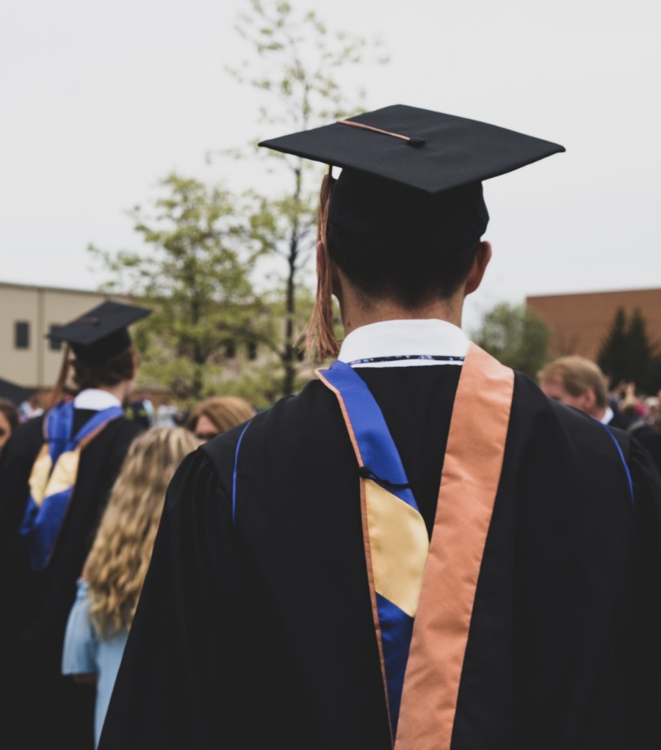
Goal
Potential benefit to Washington State
  Ensure that students in Bellevue have the food, clothing, housing assistance and educational support they need to achieve and graduate at the same rate as the rest of the student body by 2025.
$1
million
65
graduates
$65 MILLION
in savings per year**
With this gap closed, 65 more students will graduate on time each year.*
Copyright 2025 Altruist Impact Accelerator, all rights reserved.
Licensed for noncommercial use only under the Terms of Service.

Slide 10


Strategies
Our ambition is to ensure the benefits of our programs reach ALL children living in poverty in Bellevue.
In order to accomplish this, we will:
Support every child’s basic needs – food, clothing and housing – over the long term, focusing on those that qualify for the Federal Free & Reduced Price Lunch program.
Fund summer school and credit recovery programs for high-schoolers.
Be the voice for children and families in Bellevue.
Metrics:
More clients served
Changes in key indicators – attendance, achievement gap reduction, behavior
Metrics:
Graduation rates
Metrics:
Public and private funding
Copyright 2025 Altruist Impact Accelerator, all rights reserved.
Licensed for noncommercial use only under the Terms of Service.

Slide 11
Key to Success
Program Strategy
Strong Partnerships
Scale
Resources
Align impact with Bellevue School District and engage community with measured impact
Data-Driven Performance
Copyright 2025 Altruist Impact Accelerator, all rights reserved.
Licensed for noncommercial use only under the Terms of Service.

Slide 12
Growth
STAFF PLAN
Executive Director
Associate
Director
Human Services Administrator
Human Services Administrator
Human Services Administrator
Accounting Manager
Content & Graphic Design Coordinator
Volunteer & Administrative Coordinator
Partnerships & Investments Director
Partnerships & Investments Officer
Development
Coordinator
Current
2019
Executive Assistant
Thrift Shop
Manager
Thrift Shop Staff
Future
Program Delivery
BUDGET & SERVICE LEVELS
Meeting 100% of the need
Copyright 2025 Altruist Impact Accelerator, all rights reserved.
Licensed for noncommercial use only under the Terms of Service.

Slide 13
Timeline
2019
2020
2021+
Improved client follow-up
Launch community Ambassadors
Local government funding
Aligned metrics with Bellevue School District
Increase Human Service Administrator staff
Refine Thrift Culture offerings
Member Circle expansion
Launch first corporate-affiliated Circle
Increase Partnerships & Investment staff
Community outreach plan
Thrift Culture POS analysis
Advocacy agenda
Corporate partnerships
Copyright 2025 Altruist Impact Accelerator, all rights reserved.
Licensed for noncommercial use only under the Terms of Service.

